Slide 1

JavaScript
(Continued)

Slide 2
4.7 Object Creation and Modification
The new expression is used to create an object
  This includes a call to a constructor
  The new operator creates a blank object, or one with no properties
Properties of an object are accessed using a dot notation: object.property
Properties are not variables, just names of values and are not declared
The number of properties of an object may vary dynamically in JavaScript

Slide 3
4.7 Dynamic Properties
The number of properties in JavaScript object is dynamic
Example : Create my_car and add some properties
  // Create an Object object
  var my_car = new Object();
  // Create and initialize the make property
  my_car.make = "Ford";
  // Create and initialize model
  my_car.model = "Contour SVT";
  OR
  Var my_car= {make: “Ford”, model: “Contour SVT”};

Slide 4
4.7 Dynamic Properties contnd..
Objects can also be nested
A new object can be created that is a property of my_car with properties of its own as follows:
Example:
my_car.engine= new Object();
my_car.engine.config = “V6”;
my_car.engine.hp = 200;
Properties can be accessed in two ways:
    object-dot-property notation
    As if they were elements of an array using the property name as the subscript

Slide 5
4.7 Dynamic Properties contnd..
  Example:
var prop1 = my_car.make;
var prop2 = my_car [ “make” ];
If an attempt is made to access a property of an object that does not exist, the value undefined is used
The delete operator can be used to delete a property from an object
  delete my_car.model

Slide 6
4.7 The for-in Loop
Used in listing the properties of an object
Syntax
  for (identifier in object)
  statement or compound statement
The loop lets the identifier take on each property in turn in the object
Printing the properties in my_car:
  for (var prop in my_car)
  document.write("Name: ", prop, "; Value: ",
  my_car[prop], "<br />");
Result:
  Name: make; Value: Ford
  Name: model; Value: Contour SVT

Slide 7
4.8 Arrays
Arrays are lists of elements indexed by a numerical value
Array indexes in JavaScript begin at 0
Arrays can be modified in size even after they have been created (dynamic)

Slide 8
4.8 Array Object Creation
Arrays can be created using the new Array method
  new Array with one parameter creates an empty array of the specified number of elements
    var my_list=new Array(10)
  new Array with two or more parameters creates an array with the specified parameters as elements
    var my_list=new Array(10, 20)
Arrays can also be created with Literal arrays which is a list of values enclosed in square brackets
  var alist = [1, “ii”, “gamma”, “4”];
Elements of an array do not have to be of the same type

Slide 9
4.8 Characteristics of Array Objects
The length of an array is one more than the highest index to which a value has been assigned or the initial size (using Array with one argument), whichever is larger
Assignment to an index greater than or equal to the current length simply increases the length of the array
Only assigned elements of an array occupy space
  Suppose an array were created using new Array(200)
  Suppose only elements 150 through 174 were assigned values
  Only the 25 assigned elements would be allocated storage, the other 175 would not be allocated storage

Slide 10
4.8 Example insert_names.js
This example shows the dynamic nature of arrays in JavaScript

Slide 11
4.8 Array Methods
join
-- converts all of the elements of an array to strings and catenates them into a single string
reverse
--reverses the order of the elements of the Array object through which it is called
sort
--coerces the elements of the array to strings, if they are not already strings, and sorts them alphabetically
concat
--catenates its actual parameters to the end of the Array object on which it is called

Slide 12
4.8 Dynamic List Operations
slice ---it returns the part of the Array object specified by its parameter
push --Adds element to the high end of the array
pop --Removes from the high end of the array
shift --Removes element from the beginning of the array
unshift –Adds elements to the beginning of the array
Example:
var list = [“first”, ”second”, ”third”];
var temp= list.pop(); // temp=“third”
list.push(“third”);
var temp = list.shift(); //temp=“first”
list.unshift(“first”); //puts “first” back on the list

Slide 13
4.8 Two-dimensional Arrays
A two-dimensional array in JavaScript is an array of arrays
  This need not even be rectangular shaped: different rows could have different length
Example nested_arrays.js illustrates two-dimensional arrays

Slide 14
4.9 Function Fundamentals
Function definition syntax
  A function definition consist of a header followed by a compound statement
  A function header:
    function function-name(optional-formal-parameters)
return statements
  A return statement causes a function to cease execution and control to pass to the caller
  A return statement may include a value which is sent back to the caller
    This value may be used in an expression by the caller
  A return statement without a value implicitly returns undefined
Function call syntax
  Function name followed by parentheses and any actual parameters
  Function call may be used as an expression or part of an expression
Functions must defined before use in the page header

Slide 15
4.9 Functions are Objects
Functions are objects in JavaScript
Function’s addresses can be properties in other objects, in which case they act as methods
Example
  function fun() {
  document.write( "This surely is fun! <br/>");
  }
  ref_fun = fun; // Now, ref_fun refers to the fun object
  fun(); // A call to fun
  ref_fun(); // Also a call to fun

Slide 16
4.9 Local Variables
“The scope of a variable is the range of statements over which it is visible”
A variable not declared using var has global scope, visible throughout the page, even if used inside a function definition
A variable declared with var outside a function definition has global scope
A variable declared with var inside a function definition has local scope, visible only inside the function definition
  If a global variable has the same name, it is hidden inside the function definition and the local variable has the precedence over the global variable

Slide 17
4.9 Parameters
Parameters named in a function header are called “formal parameters”
Parameter values that appear in a call to a function are called “actual parameters”
Parameters are passed by value
  For an object parameter, the reference is passed, so the function body can actually change the object
  However, an assignment to the formal parameter will not change the actual parameter

Slide 18
4.9 Parameter Passing Example
function fun1(my_list) {
var list2 = new Array(1, 3, 5);
my_list[3] = 14;
...
my_list = list2;
...
}
...
var list = new Array(2, 4, 6, 8)
fun1(list);
The first assignment changes list in the caller
The second assignment has no effect on the list object in the caller
Pass by reference can be simulated by passing an array containing the value

Slide 19
4.9 Parameter Checking
JavaScript checks neither the type nor number of parameters in a function call
  Formal parameters have no type specified
  Extra actual parameters are ignored (however, see below)
  If there are fewer actual parameters than formal parameters, the extra formal parameters remain undefined
A property array named arguments holds all of the actual parameters, whether or not there are more actual parameters than number of formal parameters
There is no proper way to pass a primitive value by reference
Improper way is to put the value into an array and pass the array

Slide 20
4.9 Parameter Checking contd…
Example:
function fun(a){
a[0] *= 10; }
…..
var x;
var listx = new Array(1);
…..
listx[0]=x;
fun(listx);
x=listx[0];

Slide 21
4.9 Parameter Checking contd…
Another way is to return the new value from the function to the caller
Example:
function fun(a){
return 10*a;
}
var x;
x= fun(x);

Slide 22
4.9 The sort Method, Revisited
If you need to sort something other than strings, or if you want an array to be sorted in some order other than alphabetically as strings, the comparison operation must be supplied to the sort method by the caller.
A parameter can be passed to the sort method to specify how to sort elements in an array
  The parameter is a function that takes two parameters
  The function returns a negative value to indicate the parameters are in the desired order
  The function returns a positive value to indicate that the numbers must be interchanged
  The function returns 0 to indicate the first parameter and the second parameter are equivalent as far as the ordering is concerned

Slide 23
4.11 Constructors
Constructors are functions that create and initialize properties for new objects
A constructor uses the keyword this in the body to reference the object being initialized
A method can be inserted in the object in the same way as a data property.

Slide 24
4.12 Pattern Using Regular Expressions
Regular expressions are used to specify patterns in strings
JavaScript provides two methods to use regular expressions in pattern matching
  String methods
  RegExp objects (not covered in the text)
A literal regular expression pattern is indicated by enclosing the pattern in slashes
The search method returns the position of a match, if found, or -1 if no match was found

Slide 25
4.12 Example Using search
var str = "Rabbits are furry";
var position = str.search(/bits/);
if (position > 0)
document.write("'bits' appears in position",
position, "<br />");
else
document.write(
"'bits' does not appear in str <br />");
This uses a pattern that matches the string ‘bits’
The output of this code is as follows:
  'bits' appears in position 3

Slide 26
4.12 Characters and Character-Class Patterns
Metacharacters have special meaning in regular expressions
  \ | ( ) [ ] { } ^ $ * + ? .
  These characters may be used literally by escaping them with \
Other characters represent themselves
A period matches any character other than newline
  /f.r/ matches for and far and fir but not fr
  if you want to match /3.4/?
A character class matches one of a specified set of characters
  [character set]
  List characters individually: [abcdef]
  Give a range of characters: [a-z]
  Beware of [A-z]
  circumflex (^) at the beginning negates the class

Slide 27
4.12 Predefined character classes
Name | Equivalent Pattern | Matches
\d | [0-9] | A digit
\D | [^0-9] | Not a digit
\w | [A-Za-z_0-9] | A word character (alphanumeric)
\W | [^A-Za-z_0-9] | Not a word character
\s | [ \r\t\n\f] | A whitespace character
\S | [^ \r\t\n\f] | Not a whitespace character

Slide 28
4.12 Repeated Matches
A pattern can be repeated a fixed number of times by following it with a pair of curly braces enclosing a count
A pattern can be repeated by following it with one of the following 3 symbolic quantifiers:
  * indicates zero or more repetitions of the previous pattern
  + indicates one or more of the previous pattern
  ? indicates zero or none of the previous pattern
Examples
  /\(\d{3}\)\d{3}-\d{4}/ might represent a telephone number
  /[A-Za-z]\w*/ matches identifiers
  /x*y+z?/-----???
  /\d+\.\d*/-----???

Slide 29
4.12 Repeated Matches contd…
One additional named pattern \b (boundary) that matches the boundary position between a word character (\w) and a nonword character (\W), in either order
Example:
    /\bis\b/ matches
    “ A tulip is a flower” but not “A frog isn’t”
Boundary pattern does not match a character it matches the position between two characters

Slide 30
4.12 Anchors
Anchors in regular expressions match positions rather than characters
  Anchors are 0 width and may not take multiplicity modifiers
Anchoring to the end of a string
  ^ at the beginning of a pattern matches the beginning of a string
  $ at the end of a pattern matches the end of a string
    The $ in /a$b/ matches a $ character
Anchoring at a word boundary
  \b matches the position between a word character and a non-word character or the beginning or the end of a string
  /\bthe\b/ will match ‘the’ but not ‘theatre’ and will also match ‘the’ in the string ‘one of the best’

Slide 31
4.12 Pattern Modifiers
Pattern modifiers are specified by characters that follow the right delimiter / of a pattern
Modifiers modify the way a pattern is interpreted or used
The x modifier causes whitespace in the pattern to be ignored
  This allows better formatting of the pattern
  \s still retains its meaning
The i modifier makes the letters in the pattern match either lowercase or uppercase
Example: /Apple/i matches any combination of uppercase and lowercase spellings of the word “apple”
The g modifier is explained in the following

Slide 32
4.12 Other Pattern Matching Methods
The replace method takes a pattern parameter and a string parameter
  The method replaces a match of the pattern in the target string with the second parameter
  A g modifier on the pattern causes multiple replacements
Parentheses can be used in patterns to mark sub-patterns
  The pattern matching machinery will remember the parts of a matched string that correspond to sub-patterns
The match method takes one pattern parameter
  Without a g modifier, the return is an array of the match and parameterized sub-matches
  With a g modifier, the return is an array of all matches
The split method splits the object string using the pattern to specify the split points

Slide 33
4.13 An Example
forms_check.js
Using javascript to check the validity of input data
Note, a server program may need to check the data sent to it since the validation can be bypassed in a number of ways

Slide 34
4.14 Errors in Scripts
JavaScript errors are detected by the browser
Different browsers report this differently
  Firefox uses a special console
Support for debugging is provided
  In IE 7, the debugger is part of the browser
  For Firefox 2, plug-ins are available
    These include Venkman and Firebug

Slide 35
Chapter 5
JavaScript and
HTML Documents

Slide 36
5.1 JavaScript Execution Environment
DOM originated as a specification to allow JavaScript scripts and Java programs to be portable among Web browsers
A browser displays an XHTML document in a window on the screen of the client side
The Window object represents the window displaying a document
  All properties of Window object are visible to all JavaScripts
  Global variables are properties of the Window object
  There can be more than one Window object
The Document object represents the document displayed
  The document property of Window
  Property arrays for forms, links, anchors, …

Slide 37
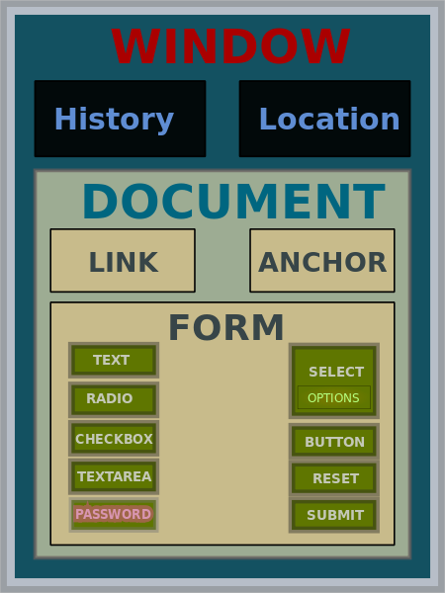
5.2 Object Hierarchy

Slide 38
5.2 Document Object Model
DOM Levels
  DOM 0: informal, early browsers
  DOM 1: XHMTL/XML structure
  DOM 2: event model, support for XML namespaces and CSS
  DOM 3: support for XPath and keyboard event handling, interface for serializing documents as XML
DOM is an API that defines an interface between XHTML documents and application programs
Each language that interfaces with the DOM must define a binding to that interface
DOM specification consists of a collection interfaces, including one for each document tree node type

Slide 39
5.2 Document Object Model
DOM specifications describe an abstract model of a document
  Interfaces describe methods and properties
  The interfaces describe a tree structure
  Different languages will bind the interfaces to specific implementations
    In JavaScript, data are called as properties and operations are called as methods
Example:
<input type = “text” name=“address”>
The above element would be represented as an object with two properties, type and name with the values “text” and “address”.

Slide 40
5.2 Example
The XHTML document is shown as a conceptual tree
Attributes of elements become named properties of element node objects
Example:
<html>
<head><title> A simple document </title></head>
<body>
<table>
<tr>
<th>Breakfast</th>
<td> 0</td><td>1</td>
</tr>
<tr>
<th> Lunch</th>
<td> 1 </td> <td> 0 </td>
</tr>
</table><
/body>
</html>

Slide 41
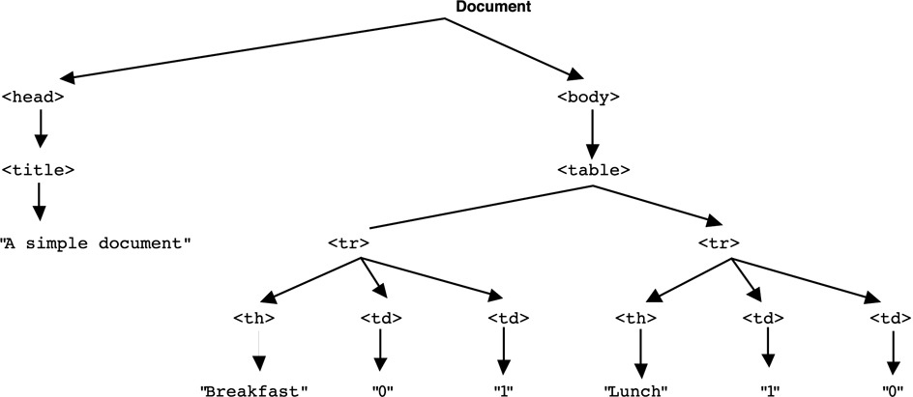
Figure 5.1 The DOM structure for a simple document

Slide 42
5.3 Element Access in JavaScript
Elements in XHTML document correspond to objects in JavaScript
The addresses of these objects are required, both by the event handling and by the code to make dynamic changes to documents
Objects can be addressed in several ways:
  forms and elements array defined in DOM 0
    Using document property of the Window object
    Individual elements are specified by index
    The index may change when the form changes
  Using the name attributes for form and form elements
    A name on the form element causes validation problems
    Names are required on form elements providing data to the server
  Using getElementById with id attributes
    id attribute value must be unique for an element

Slide 43
5.3 Using forms array
Address of the JavaScript object that is associated with an XHTML element is called as DOM address
Consider this simple form:
<form action = "">
<input type = "button" name=“turnItOn">
</form>
The input element can be referenced as
  var dom = document.forms[0].element[0]
Disadvantage:
  The element address could change through which DOM address is defined
  Ex: Addition of a new button before the turnItOn button

Slide 44
5.3 Using name Attributes
All elements from the reference element up to, but not including, the body must have a name attribute
Example
  <form name = "myForm" action = "">
  <input type = "button" name = “rdType">
  </form>
Referencing the input
  var dom = document.myForm.rdType
Disadvantage:
The XHTML 1.1 standard does not allow the name attribute in the form element, this is a validation problem

Slide 45
5.3 Using id Attribute
Set the id attribute of the input element
  <form action = "">
  <input type="button" id=“turnItOn">
  </form>
Then use getElementById
  var dom=document.getElementById(“turnItOn")

Slide 46
5.3 Alternative to names and ids
Used for checkboxes and radio buttons
Implicit arrays associated with each checkbox and radio button group is used
These arrays are properties of the form in which the buttons appear
To access the arrays, first we need to get the address of the form object
Ex:
<form id = “vehicleGroup”>
<input type=“checkbox” name=“vehicle” value=“car”/>Car
<input type=“checkbox” name=“vehicle” value=“car”/>Truck
<input type=“checkbox” name=“vehicle” value=“car”/>Bike
</form>

Slide 47
5.3 Alternative to names and ids
The implicit array vehicle has three elements
To search the list of checkboxes in a group for which is checked the array is used
The following code counts the number of checkboxes that were checked
var numChecked = 0;
var dom = document.getElementById(“vehicleGroup”);
for(var i=0;i<dom.vecle.length;i++)
if(dom.vehicle[i].checked)
numChecked++;

Slide 48
5.4 Events and Event Handling
Event-driven programming is a style of programming in which pieces of code, event handlers, are written to be activated when certain events occur
Events represent activity in the environment including, especially, user actions such as moving the mouse or typing on the keyboard
An event handler is a script that is designed to execute when a certain event occurs
Most common use of event handler is to validate data at the client side which saves time of sending data to server for validating

Slide 49
5.4 Events and Event Handling
Events are JavaScript objects, their names are case sensitive
Ex: click is an event but Click is not
Registration is the activity of connecting an event handler to an event
  Assign an event handler to tag attributes
  Assign handler address to object properties (DOM node)
The write method of document should never be used in the event handler
Because usually events occur after the whole document is displayed
If write appears in an event handler, the contents generated by it might be placed over the top of the existing document

Slide 50
5.4 Events, Attributes and Tags
HTML4 defines a collection of events, which browser implement and with which JavaScript can deal
These events are associated with XHTML tag attributes, which can be used to connect the events to handler
The attribute for one kind of event may appear on different tags allowing the program to react to events affecting different components
A text element gets focus in three ways:
  When the user puts the mouse cursor over it and presses the left button
  When the user tabs to the element
  By executing the focus method
The keyboard input goes into that element
Losing the focus is blurring

Slide 51
5.4 Events, Attributes and Tags
Event Tag Attribute
blur onblur
change onchange
click onclick
focus onfocus
load onload
mousedown onmousedown
mousemove onmousemove
mouseout onmouseout
mouseover onmouseover
mouseup onmouseup
select onselect
submit onsubmit
unload onunload

Slide 52
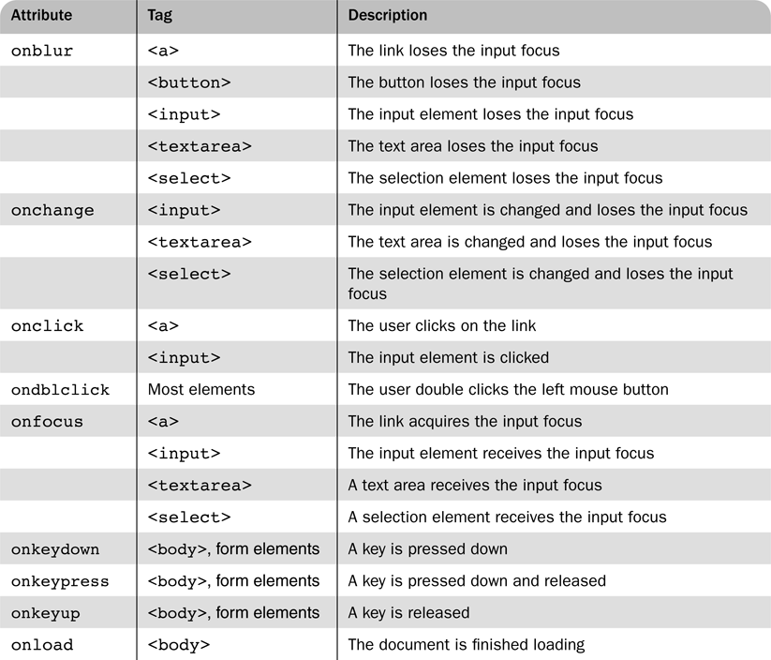
Table 5.2 Event attributes and their tags

Slide 53
5.4 Event Handler Registration in DOM0
Assigning the event handler script to an event tag attribute:
  <input type=“button” name=“myButton” onclick=“alert(‘You clicked the button!’)”/>
A function call can be used if the handler is longer than a single statement
  <input type=“button” name=“myButton” onclick=“myHandler();”/>
OR
The event handler could also be registered by assignment to the associated event property on the button object
document.getElementById(“myButton”).onclick = myHandler;

Slide 54
5.5 Handling Events from Body Elements
The events most often created by body elements are :
    load
    unload
This example illustrates a script that is run when the page first loads so it uses onload attribute of <body> to specify the event handler
The unload property can be used to do some clean up before a document is unloaded.
Example: if the document has opened a new window, that window should be closed by an unload event handler

Slide 55
5.6 Handling Events from Button Elements
An event can be registered for this tag in two ways
  <input type=“button” name=“freeOffer”
  id=“freeButton”/>
Using an event attribute
  <input type=“button” name=“freeOffer”
  id=“freeButton”
  onclick=“freebuttonHandler();”/>
Assigning to a property of the element node
  document.getElementById(“freeButton”).onclick =
    freeButtonHandler;
  Note that the function name, a reference to the function, is assigned
  This statement should follow both the handler function and the XHTML form specification so that JavaScript has seen both before assigning the property

Slide 56
5.6 Checkboxes and Radio Buttons
Example radio_click.html illustrates a script that displays an alert when a radio button is clicked
  Note that a parameter is passed to the handler function
In example radio_click2.html, a reference to the handler function is assigned to the appropriate property of each element node
  Note that no parameters are passed to the function when called by the JavaScript system
  The handler code must identify the element that caused the call

Slide 57
5.6 Comparing Registration Methods
Assigning to an attribute is more flexible, allowing passing parameters without having to create an anonymous function
Assigning to a node property helps separate XHTML and JavaScript code
Assigning to a node property allows to change the handler later if needed

Slide 58
5.7 Handling Events from Text Box and Password Elements
Text boxes and passwords can create 4 different events:
    blur
    focus
    change
    select
By manipulating the focus event the user can be prevented from changing the amount in a text input field
  Example nochange.html illustrates ‘blurring’ a field whenever it gains focus

Slide 59
5.7 Validating Form Input
Validating data using JavaScript provides quicker interaction for the user
Validity checking on the server requires a round-trip for the server to check the data and then to respond with an appropriate error page
Handling a data validity error
  Produce an alert message indicating error--- alert
  Put the focus in the field in question --- focus
  Highlight the text for easier editing ---select
If an event handler returns false, default actions are not taken by the browser
  This can be used in a Submit button event handler to check validity and not submit if there are problems
Example pswd_chk.html illustrates validity checking

Slide 60
5.7 Validating Input
The validator.html example demonstrates using regular expressions to validate text input
The name is First, Last, Middle-Initial, each part capitalized
  /^[A-Z][a-z]+, ?[A-Z][a-z]+, ?[A-Z]\.?$/
The phone is ddd-ddd-dddd where d is a digit
  /^\d{3}-\d{3}-\d{4}$/
Each pattern uses the ^ and $ anchors to make sure that there are no leading or trailing characters

Slide 61
5.8 DOM 2 Event Model
DOM 2 is modularized interface
The Events module defines several submodules
  HTMLEvents and MouseEvents are most commonly used
An event object is implicitly passed as a parameter to an event handler
  Properties of this object provide information about the event
  Some event types will extend the interface to include information relevant to the subtype.
  For example, a mouse event will include the location of the mouse at the time of the event
DOM2 is relatively complex and does not include the features of DOM0
The drawback of using this model is that Microsoft does not support this model for its browsers

Slide 62
5.8 Event Propagation
DOM 2 defines a process for determining which handlers to execute for a particular event
The event object representing the event is created at a particular node called the target node in the document tree
Event creation causes a three phase process to begin

Slide 63
5.8 Event Propagation (continued)
The capturing phase: each node from the document root to the target node, in order, is examined.
  If the node is not the target node and there is a handler for that event at the node and the handler is enabled for capture for the node, the handler is executed
Then all handlers registered for the target node, if any, are executed
The bubbling phase: each node from the parent of the target node to the root node, in order, is examined
  On this trip back up the tree, any handler registered for the event at any node on the way is executed (whether it is enabled or not)
  Some event types are not allowed to bubble: load, unload, blur and focus among the HTML event types
  All the mouse events can bubble
Any handler can stop the event from further propagation , using the stopPropagation method of the event object

Slide 64
5.8 Event Propagation
In a large and complicated document, having event handlers for every element would require a great deal of code
One major advantage of this scheme over DOM 0 is that event handling can be centralized in an ancestor node
In DOM the central place for event handling is either document or window level so that is the direction for bubbling
For example, a calculator keyboard will have a number of digit buttons
  In some GUI frameworks, a handler must be added to each button separately
  In DOM 2, the buttons could be organized under a single node and the handler placed on the node
To prevent the default action performed by the browser preventDefault method of event object is used

Slide 65
5.8 Event Handler Registration
Handlers are called listeners in DOM 2
addEventListener is used to register a handler, it is defined in the EventTarget interface, it takes three parameters
When a handler is called, it is passed a single parameter, the event object
  A string, name of the event eg:mouseup, submit etc…
  The handler function (function code itself or name of the function)
  A Boolean specifying whether the handler is enabled for the capture phase or not
We can also have a temporary handler, this can be done by registering the handler for the time when it is to be used and delete that registration using removeEventListener
currentTarget property of Event, which will reference the object on which the handler is being executed
Another property target of event object refers to the target node

Slide 66
5.8 Example of DOM 2 Event Model
MouseEvent interface has collection of properties related to mouse events
Most usefull of these are clientX and clientY, which have the x and y coordinates of the mouse cursor referring to the browser window
The validator2.html example modifies the validation example to use DOM 2 style event handling

Slide 67
5.9 The navigator Object
Properties of the navigator object allow the script to determine characteristics of the browser in which the script is executing
The appName property gives the name of the browser
The appVersion gives the browser version

Slide 68
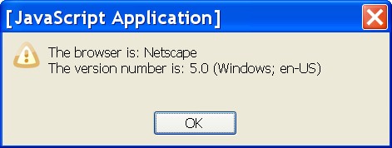
5.9 Output From navigate.html
Note that the browser is actually FireFox and the version is 2.0.0.4

Slide 69
5.10 DOM Tree Traversal and Modification
Each element in an XHTML document has a corresponding ELEMENT object in the DOM representation
The ELEMENT object has methods to support
  Traversing the document, that is, visiting each of the document nodes
  Modifying the document
    For example, removing and inserting child nodes

Slide 70
5.10 DOM Tree Traversal
Various properties of Element objects are related nodes
parentNode references the parent node of the Element
previousSibling and nextSibling connect the children of a node into a list
firstChild and lastChild reference children of an Element
  These would be text nodes or element nodes contained in the Element

Slide 71
5.10 DOM Tree Modification
The insertBefore method inserts a new child of the target node
replaceChild will replace a child node with a new node
removeChild removes a child node
appendChild adds a node as a child node at the end of the children

